Slide 1
Linked & Embedded Objects

Slide 2
What is OLE?
You can use Object Linking and Embedding (OLE) to include content from other programs, such as Word or Excel.
OLE is supported by many different programs, and OLE is used to make content that is created in one program available in another program.

Slide 3
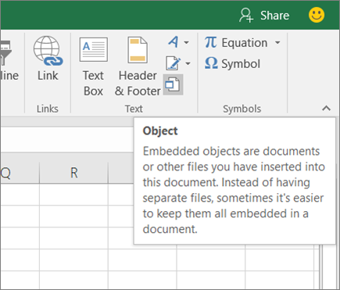
Embed an object in a worksheet
Click inside the cell of the spreadsheet where you want to insert the object.
On the Insert tab, in the Text group, click Object

Slide 4
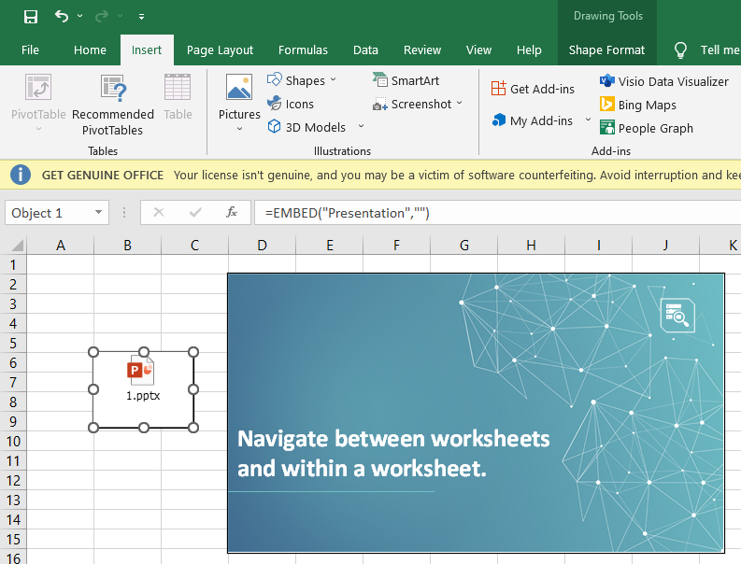
Embed an object in a worksheet (Cntd…)
In the Object dialog box, click the Create from File tab.
Click Browse, and select the file you want to insert.
If you want to insert an icon into the spreadsheet instead of show the contents of the file, select the Display as icon check box. If you don’t select any check boxes, Excel shows the first page of the file. In both cases, the complete file opens with a double click. Click OK.

Slide 5
Insert a Link to a File
You might want to just add a link to the object rather than fully embedding it.
You can do that if your workbook and the object you want to add are both stored on a SharePoint site, a shared network drive, or a similar location, and if the location of the files will remain the same.
This is handy if the linked object undergoes changes because the link always opens the most up-to-date document.

Slide 6
Insert a Link to a File (Cntd…)
Click inside the cell of the spreadsheet where you want to insert the object.
On the Insert tab, in the Text group, click Object

Slide 7
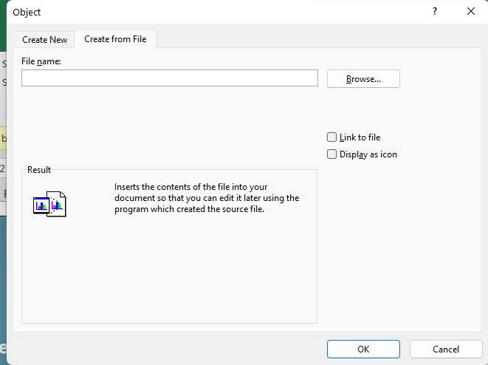
Insert a Link to a File (Cntd…)
Click the Create from File tab.
Click Browse, and then select the file you want to link.
Select the Link to file check box, and click OK.

Slide 8
Create a new object from inside Excel
You can create an entirely new object based on another program without leaving your workbook.
For example, if you want to add a more detailed explanation to your chart or table, you can create an embedded document, such as a Word or PowerPoint file, in Excel.
You can either set your object to be displayed right in a worksheet or add an icon that opens the file.

Slide 9
Create a new object from inside Excel (Cntd…)
Click inside the cell of the spreadsheet where you want to insert the object.
On the Insert tab, in the Text group, click Object

Slide 10
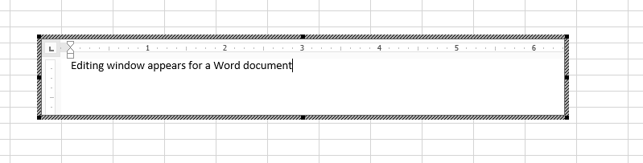
Create a new object from inside Excel (Cntd…)
On the Create New tab, select the type of object you want to insert from the list presented. If you want to insert an icon into the spreadsheet instead of the object itself, select the Display as icon check box.
Click OK. Depending on the type of file you are inserting, either a new program window opens or an editing window appears within Excel.
Create the new object you want to insert.

Slide 11
Tasks
Why we use Embedding & Linking?
Embed a PPTX file into your excel worksheet. (with display as icon & without display as icon).
Link a Word file in your worksheet with display as icon and open it from there.
Link a notepad file in your worksheet & open it.
Embed a picture in your worksheet.
Link a Word file in your worksheet, from another drive. (Your Word file and excel file must not be in the same drive)
Create an object of word file in you worksheet.
Create an object of Microsoft graph chart in you worksheet.
Create an object of wordpad document.

Slide 12
THANKS

